Slide 1




LIU
BE MY
EYES
Start Slide

Slide 2


LIU
ABOUT BE MY EYES
Be My Eyes is an application designed to empower individuals with visual impairments by providing real-time assistance through their smartphones
It provide real-time object detection and recognition with voice and text feedback

Slide 3
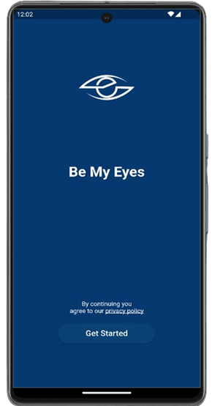
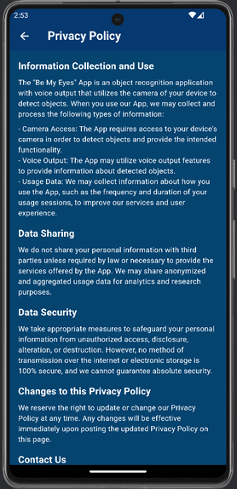
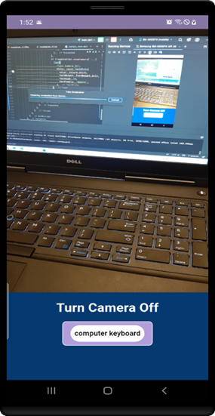
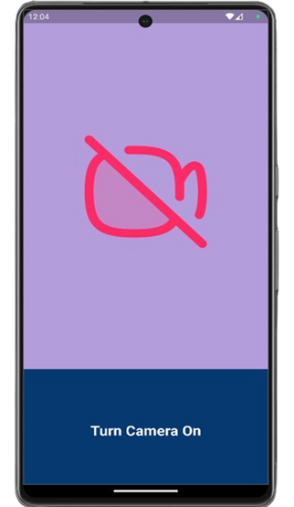
LIU
FEATURES
1
Simply tap on "Get Started" signaling your agreement with our privacy policy.
2
When the button is turned on, the upper section of the screen showcases the live feed captured by the camera, providing real-time insight. The lower section contains a camera control button that allows users to turn off the live broadcast with a text description for objects.
When the button is turned off, the upper section of the screen shows a camera off icon, indicating that the live feed is inactive. The lower section contains a camera control button that allows users to start the live broadcast.
3
4

Slide 4
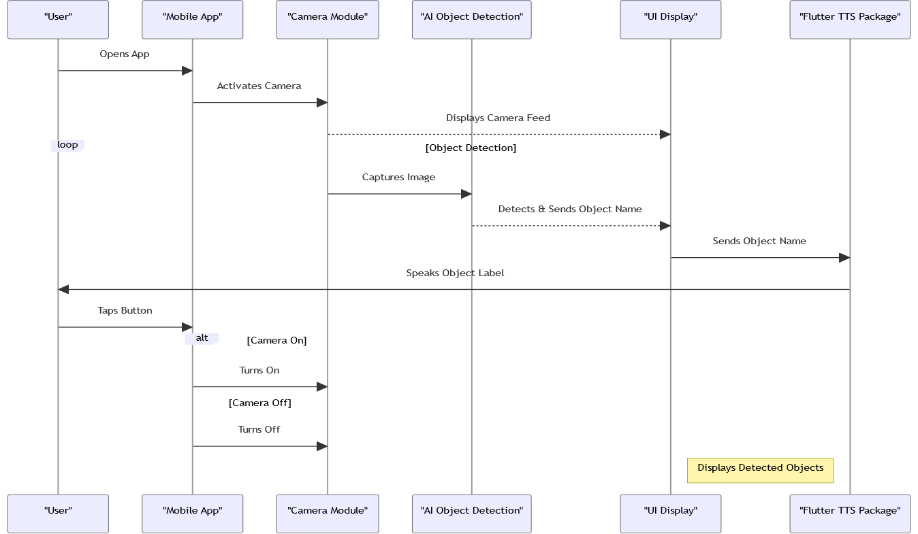
LIU
SYSTEM ARCHITECTURE

Slide 5

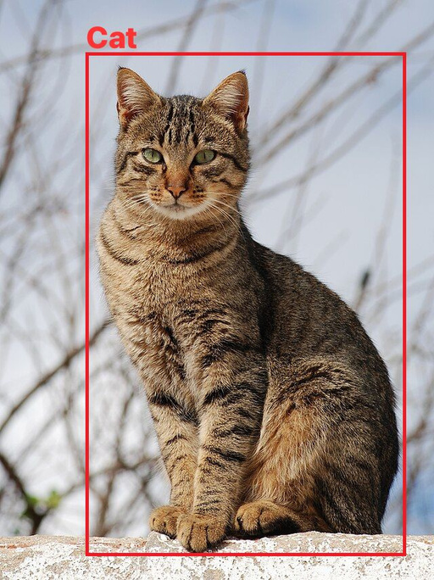
LIU
OBJECT RECOGNITION
A remarkable computer vision Technique which enables the computer to identify specific objects within an image and to also determine their precise location within the image.
Object Localization : involves identifying and locating objects in an image for tasks like detection, tracking, and segmentation. It uses regression to find the coordinates of the box's top-left and bottom-right corners, defining a rectangle around the object.

Slide 6
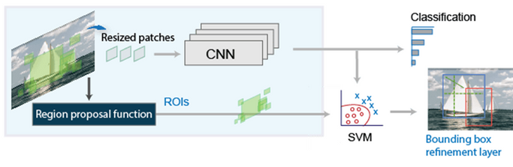
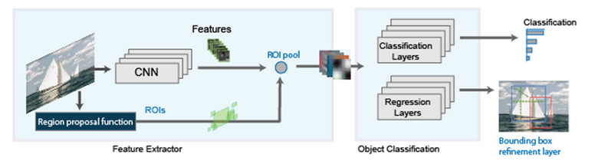
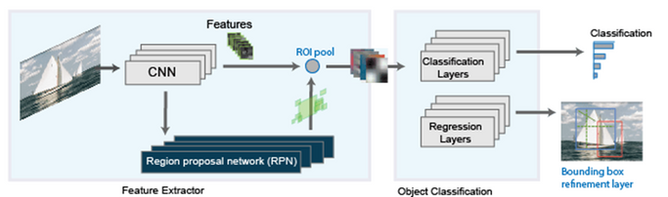
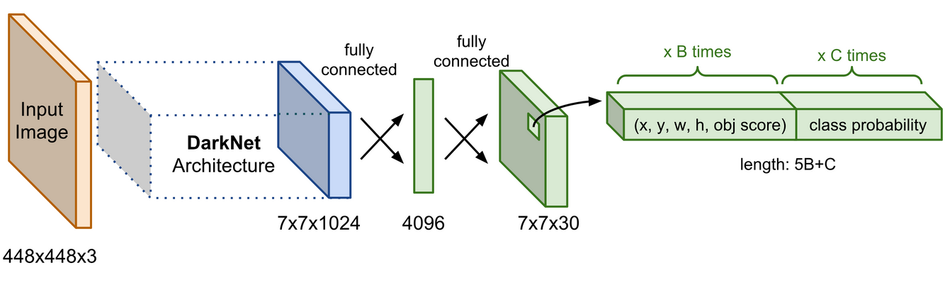
LIU
MODELS
R-CNN generates region proposals using an algorithm like Edge Boxes, crops and resizes these regions, classifies them with a CNN, and refines the bounding boxes with an SVM trained on CNN features.
2
Fast R-CNN, like R-CNN, uses algorithms like Edge Boxes for region proposals but processes the entire image instead of cropping and resizing each region. It pools CNN features for each proposal, sharing computations for overlapping regions, making it more efficient than R-CNN.
1
Faster R-CNN adds a region proposal network (RPN) to generate proposals directly within the network using Anchor Boxes, instead of an external algorithm like Edge Boxes, making it faster and better tuned to the data.
The YOLO (You Only Look Once) algorithm revolutionizes object detection by processing the entire image in a single pass through a convolutional neural network . YOLO divides the image into a grid, Each grid cell predicts objects within its region, handling feature extraction and prediction simultaneously.
3
4

Slide 7
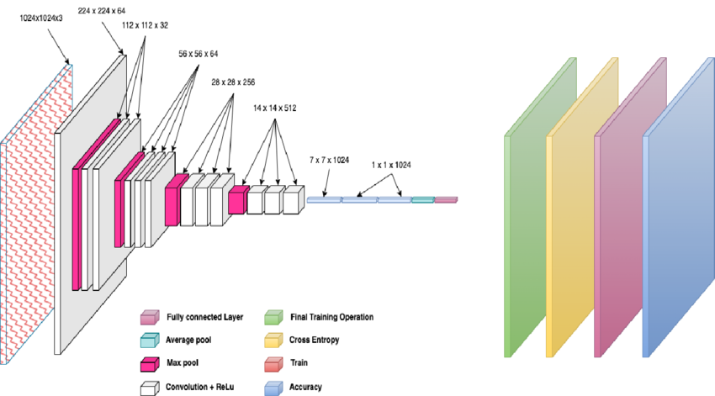
LIU
MOBILENET MODEL
MobileNetV1 has 28 layers and approximately 4.2 million parameters. It uses Depthwise Separable Convolution, which splits the depth and spatial dimensions of filters, significantly reducing parameters while maintaining effectiveness. This approach is similar to splitting the Sobel filter into height and width dimensions to reduce parameters. By separating the depth dimension and then applying a 1x1 filter, MobileNetV1 achieves efficiency in image processing tasks, requiring far fewer parameters than traditional convolutional networks.

Slide 8

LIU
ADVANTAGES OF MOBILENET
Efficiency: Optimized for mobile devices, balancing accuracy and computational load.
Low Memory: Lightweight design, suitable for devices with limited memory.
Speed: Fast inference for real-time applications.
Scalable: Can adjust model size and speed via hyperparameters.
Compatibility: Works with popular deep learning frameworks.
Versatile: Applicable to various computer vision tasks.

Slide 9
LIU
IMPLEMENTATION AND FUNCTIONALITY
1
Flutter Framework: Provides comprehensive widgets and libraries for cross-platform mobile development.
Dart Programming Language: Used for implementing application logic and user interface elements due to its simplicity and readability.
Permission Handler: Manages platform permissions, particularly camera access, ensuring compliance with privacy standards.
2
3
4
TensorFlow Lite: Enables object recognition functionality using pre-trained machine learning models for real-time detection.
Get Package: Utilized for state management, simplifying communication between application components through reactive programming principles.
Get Package: Utilized for state management, simplifying communication between application components through reactive programming principles.
5
6
7
Flutter TTS Plugin: Integrates text-to-speech conversion, enhancing accessibility for visually impaired users with auditory feedback.
Modular Widget Composition: Various Flutter widgets like MaterialApp, Scaffold, Column, Text, ElevatedButton, and RichText are strategically used to compose the UI, enhancing its visual appeal and interactivity.
Reusable Component Encapsulation: Components like StartPage and CameraView encapsulate UI elements and functionality, promoting code reusability, maintenance simplicity, and code readability.
8
9
State Management with GetX: The CameraView widget utilizes GetBuilder from the GetX state management library to efficiently handle UI state updates, ensuring responsiveness and scalability.
10

Slide 10

LIU
FUTURE WORK
Enhanced Object Recognition by Improving accuracy with advanced machine learning models.
Multimodal Interaction by enabling voice commands for easier interaction.
Integration with Other Assistive Technologies by integrating with wearable devices like smart glasses.
Expand language support for voice and text outputs.

Slide 11
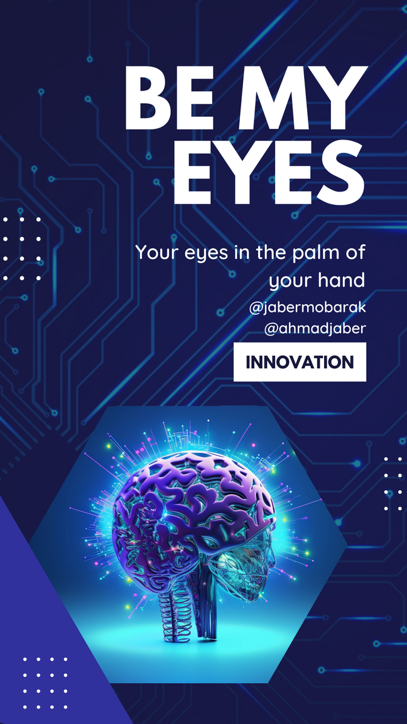
LIU
THANK
YOU
BY JABER MOBARAK & AHMAD JABER

